Slide 1
Surrey address Import
SOTM-US 2013
www.osm.org/pnorman
Notes:
Hello
Name
Introduce self
Addresses! Imports!

Slide 2
About
Import of addresses conducted in 2010-2011 in Surrey, BC
Up to now, no review of this import
Import conducted with best practices at the time
Analysis based on OSM data for BC from May 31, 2013 as well as pre-import and post-import
Analysis done with osm2pgsql database with options suitable for analysis
osm2pgsql -c -E 32610 -S addresses.style --hstore --hstore-match-only -x -G \
-C 28000 --number-processes 6 –unlogged
Some SQL from addressmerge used (https://github.com/pnorman/addressmerge)
Notes:
Back in late 2010 I imported addresses in surrey bc
As yet unreviewed
Best practices at the time, relatively little would be changed today
Analysis here based on late may osm data as well as pre/post import data, done with osm2pgsql with a custom style that got rid of everything except POIs and addresses

Slide 4
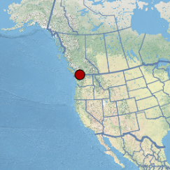
Surrey
Population of 468 thousand
Area of 316 km² (122 sq mi)
About 15 km x 25 km
Adjacent Fraser River, US border, Pacific Ocean, two other cities with the city of White Rock within its bounds
Notes:
Since you’re not familiar with surrey, a brief overview
It’s a big city, really 3 or 4 smaller cities
It borders 2 cities, but it borders the US border, ocean and fraser river

Slide 5
Farmland
About 1/3rd farmland
Not giant farms, mainly vegetables and fruits
Low mapper interest
Low object density
Few addresses
Notes:
About a third of surrey is farmland. Mostly smaller stuff, not giant wheat farms.
This farmland has a low mapper interest, but it also has a low object density and there aren’t many addresses there

Slide 6
Industrial
Sizable industrial base
Low mapper interest
Moderate object density
Moderate addresses

Slide 7
Retail/Commercial
Discrete parts of the city, far separated
Mainly street-facing retail, strip malls
High mapper interest
High object density
High address density

Slide 8
Residential
Endless boring suburbs
Difficult to map
Low mapper interest
Moderate object density
But mainly buildings with no value except display
High address density

Slide 9
Surrey releases data
Aerial imagery
Contours
Roads
Waterways
Sewers, water mains, buildings, property lots, etc
Addresses
Notes:
in 2010 surrey released open data under pddl
Useful aerial imagery and contours from LIDAR
Roads and waterways data which might be useful at some point
Assorted other less useful data
And addresses

Slide 10
What did they release for addresses?
Points near the front of the building
Fake positions for strip malls with multiple addresses on the same lot
Notes:
The position data was excellent with very few problems
There were a few issues I had but they were quite minor, nothing like the spaghetti explosions in parts of TIGER

Slide 11
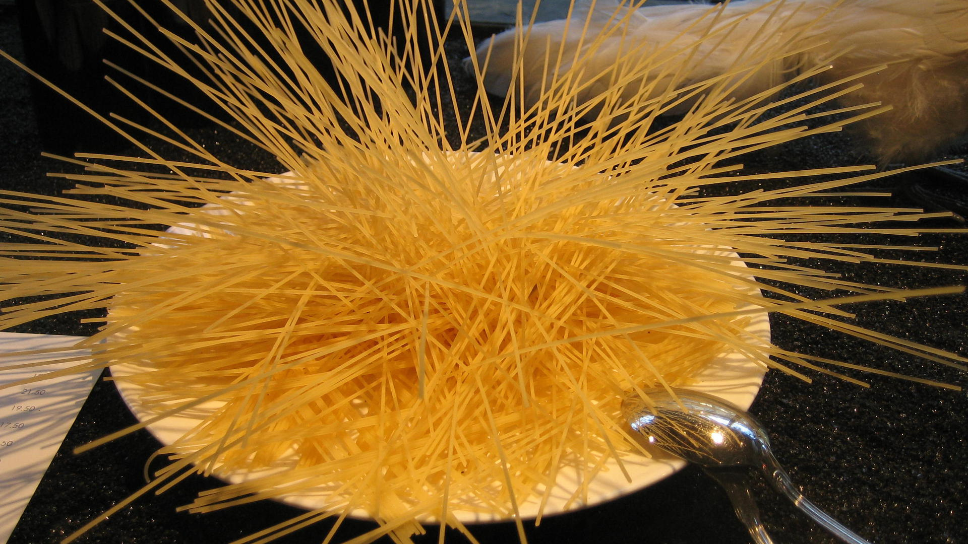
© CC BY janetmck@flickr

Slide 12
Attributes and tags
Field | Value
HOUSE_NO | 12701
ROAD_NAME | 110 Ave
BLDG_PRMT | 20040624
ADDRESS_ID | 57177
STATUS | Active (80k)/Proposed (20k, not imported)
Key | Value
addr:housenumber | 12701
addr:street | 110 Avenue
surrey:date | 20040624
surrey:addrid | 57177
addr:city | Surrey
source | City of Surrey 2010 GIS Data
Notes:
The shapefile attributes were fairly standard. There were three mistakes made here. The first was a caps issue on streets like McDonald. The other was including the address ID. As I’ve been working on code to update the address, I’ve realized that it’s useless. You have to code assuming people have added new addresses, so you can’t use it, even though the city keeps it stable and uses it as aprimary key. Fortunately, we can use the address itself like a primary key. The other is I could of chosen a better name for surrey:date
I’ll also note that STATUS is going to cause a headache in the future since it’s being dropped by the city, but overall the tagging was pretty much perfect

Slide 14
What does the data in OSM look like now?
All very well to import, but if it doesn’t get used in OSM you could accomplish the same by adding the data as another source to your geocoder
Metrics considered
Addresses merged with other data
Shows use of data
Addresses deleted
Shows that users are not put off from editing the addresses
Duplicate addresses added
Shows problems developing
Notes:
It’s all very well to import, but what I’ve described might of well as been fed into nominatim as another source like TIGER files are used when OSM doesn’t have the address, and it would have been easier to update too. If it’s in OSM and not being edited, it’s pointless
Importing a bunch of address data that is never touched will just create untouched addresses like TIGER deserts

Slide 15
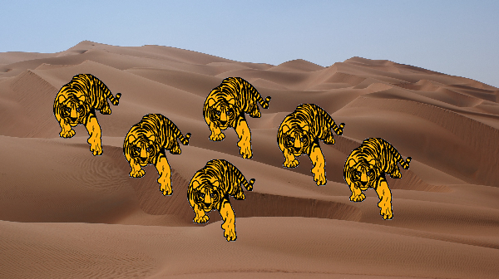

Slide 16
What does the data in OSM look like now?
All very well to import, but if it doesn’t get used in OSM you could accomplish the same by adding the data as another source to your geocoder
Metrics considered
Addresses merged with other data
Shows use of data
Addresses deleted
Shows that users are not put off from editing the addresses
Duplicate addresses added
Shows problems developing
Notes:
Three metrics were considered
Addresses merged with other data. When collecting addresses they normally go on the same node or way as some kind of POI or building
Addresses deleted. I don’t consider if a particular deletion is good or bad, but it’s important that users aren’t afraid to deleted the data if there’s been demolitions or redevelopment. We need the QA tools to determine if the deletions are good or bad, but that’s a separate matter
Duplicate addresses added. This occurs somewhat with normal mapping and isn’t specific to imported addresses

Slide 17
Metrics not considered
POIs/buildings not merged that should be
Analysis not done for complexity reasons. If you know an automated way to find these, I’m interested!
Number of users mapping
Surrey conditions are quite different from nearby cities north of the Fraser river
Anecdotal evidence is the same users are mapping in Langley, the next city to the east which also has large farmland areas

Slide 18
Pre-import state
Two addresses, both badly formatted
Simplifies import and analysis!

Slide 19
Merged addresses
Merged points
General data
Merged addresses | 205 objects | 19%
Merged to buildings | 172 objects | 20%
Merged to POIs | 55 objects | 20%
Last edited by me | 174 | 28%
Total count | 1065
Buildings | 827
POIs | 281
Last edited by me | 614
Notes:
A POI is a non-empty shop or amenity tag

Slide 20
How does this compare?
POIs require surveys when you can collect addresses anyways
Buildings can be done at home without a survey
 | Surrey | BC
Merged | 19% | 5%
Buildings | 20% | 4%
POIs | 20% | 14%
Notes:
About 4500 addressed buildings and 1200 addressed POIs

Slide 21
Addresses deleted
3 addresses deleted without merging onto something else
All by me
Not a very useful metric when you have very accurate data

Slide 22
Duplicate addresses
25 duplicates found
Mostly duplicates in the original data that were missed, likely typos by the city
Two cases found where someone added a duplicate address
But I fixed up all duplicates in December
One a user drawing a building and adding survey information
One a user de-merging (!) a POI that had been merged

Slide 23
Conclusions
Address node imports offer no immediate gain over using the data as an alternate source in your geocoder
Some evidence that address data results in more POIs with addresses

Slide 24
Contact/Credits
Paul Norman: penorman@mac.com
osm.org/user/pnorman
Background by Stamen Design, CC BY 3.0, contains information from OpenStreetMap, ODbL 1.0
Map data © OpenStreetMap contributors under ODbL. Surrey inset map data copyright Natural Earth

