Slide 1
OpenStreetMap
VancouverGIS October 2013
www.openstreetmap.org/user/pnorman
Portions of presentation courtesy Grant Slater @firefishy1

Slide 2
What is OpenStreetMap
Crowd-sourced map of the world
Crowd-sourced database of geodata
A mix of local knowledge, remote sensing and 3rd party data
An open-source project with lots of interesting technical challenges
Notes:
What is osm?
Osm is a crowd-sourced map like wikipedia is a crowd-sourced encyclopedia
It’s a crowd-sourced database of geodata. Think shapefiles, not geotiffs and other raster data

Slide 3
How do I fit in?
Started editing in 2010
Contributions have declined as I spend more time on technical, administrative, governance, developer relations and other tasks
Help develop and maintain several key pieces of software

Slide 4
openstreetmap-carto
Default map rendering on openstreetmap.org
Written in CartoCSS, a CSS like language for styling maps

Slide 5
Others
osm2pgsql: Most common software for converting OSM data to a rendering database
cgimap: Key part of the API used to retrieve map data for editing
ogr2osm: Software for converting shapefiles, KML, geodatabases, geojson, etc to .osm format

Slide 6
Working Groups
Data Working Group: Handles vandalism and editing disputes
Licensing Working Group: Licensing matters relating to using and creating OSM geodata as well as general legal matters
Engineering Working Group: Creating and maintaining resources to lower the barrier to starting developing for OSM or with OSM data

Slide 7
Notes:
http://www.openstreetmap.org/#map=11/49.1972/-122.7856

Slide 11
Notes:
http://www.openstreetmap.org/#map=11/49.1972/-122.7856

Slide 17
Editing workflow
A user downloads an area in an editor from the API
API responds with XML representation of vector data for the area
User edits locally
Editor could be a mobile app, desktop app, web-based app, or other
Working on standardizing a JSON representation for the core API

Slide 18
Editing workflow
User hits upload in their editor
Editor sends changes to server
Editor gets applied changes back

Slide 19
Editing workflow
Server creates files that can be used to update local copies of data
Rendering servers download these changes and render data
User hits reload on the webpage (sometimes twice) and sees changes
About 60 seconds between hitting upload and seeing changes

Slide 20
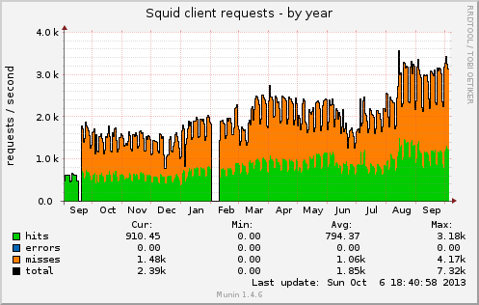
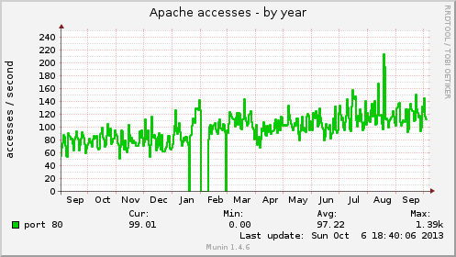
A technical challenge: Load
>1,300,000 signed up users
3000 mappers a day
4.4 million unique visitors per month (osm.org)
3.5 TB Postgresql Database
High IOPS: Concurrent Read + Write
tile.openstreetmap.org (rendered map)
Live Map updates (Minute rendering)
Average of 2800 tiles per second. (5500 tiles per second peak)
Average: 195Mbits/s out (65 TB/month, 440Mbit/s peak)
Notes:
For this slide I started with a slide from the presentation from one of our sysadmins from July and I had to increase the numbers to current

Slide 21
A technical challenge: Constraints
Older hardware
Many HP DL360 G5 servers; their CPU line was released in 2007
Rendering servers using 3 year old hardware
Limited budget (donate.openstreetmap.org)
Some components upgraded
A small volunteer team
3 OSM sysadmins
4 local sysadmins for particular machines

Slide 22
Excellent uptime
>99.7% API uptime
>99.95% planet (data dump) uptime
>99.9% tile uptime, including outages that only affected on country and a migration to a new server
>99.9% geocoder uptime
Uptimes are over the last year and include scheduled outages and upstream network failures

Slide 23
Core services: Primary
www.openstreetmap.org
api.openstreetmap.org
Editing API
planet.openstreetmap.org
Raw OSM data exports: weekly, daily, minutely, and streaming

Slide 24
Core Services: Secondary
tile.openstreetmap.org
Hundreds of other tile servers out there offering their own renderings of OpenStreetMap data
nominatim.openstreetmap.org
MapQuest runs a nominatim instance too
wiki.openstreetmap.org
Project documentation

Slide 25
Services: Tertiary
Run by us
help.osm.org (Q&A "stackoverflow")
blog.osm.org
wiki.osmfoundation.org
otrs.osm.org (support tickets)
piwik.osm.org (site visitor analytics)
munin.osm.org (monitoring)
lists.osm.org
svn.osm.org
git.osm.org
trac.osm.org
irc.osm.org
dev.osm.org (aka toolserver)
switch2osm.org
imagery
Run by others
taginfo.osm.org
forum.osm.org
ci.osm.org (Continuous Integration)

Slide 26
Servers!
Here be Dragons
bunyip draco errol eustace faffy fume gorynych horntail idris ironbelly jakelong katla lurien nadder-01 nadder-02 nepomuk noquiklos norbert orm ouroboros poldi ramoth ridgeback ridley sarel shenron smaug spike-01 spike-02 spike-03 tabaluga thorn-01 thorn-02 thorn-03 trogdor urmel yevaud zark
Total: 38
Standardizing hardware (in progress)
HP Proliant
Supermicro Superserver

Slide 27
osm.org (www)
Ruby on rails
https://github.com/openstreetmap/openstreetmap-website
Web/Rails
Server
Web/Rails
Server
Web/Rails
Server
Database
Server
File
Server

Slide 28
osm.org (www+api)
Cgimap
http://github.com/zerebubuth/openstreetmap-cgimap
Web/Rails
Server
Web/Rails
Server
Web/Rails
Server
Rails
Server
+ cgimap
Rails
Server
+cgimap
Rails
Server
+cgimap
Database
Server
File
Server

Slide 29
osm.org database
PostgreSQL 9.1
Streaming replication to 1-2 read servers
3.5TB of data
Primary DB Server
Slave DB Server
Slave DB Server

Slide 30
Data export
Raw OSM XML or binary format data
http://planet.osm.org/
Streaming diffs
Minutely diffs
Daily diffs
Weekly dumps – 370GB uncompressed

Slide 31
Tile Rendering
2 live rendering servers
PostGIS (osm2pgsql)
mod_tile
Apache module
http://github.com/openstreetmap/ mod_tile
Map stylesheet
http://github.com/gravitystorm/ openstreetmap-carto

Slide 32
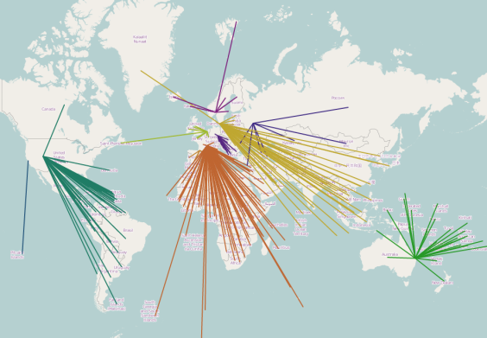
Tile CDN
11 caching servers around the world
http://dns.openstreetmap.org/ tile.openstreetmap.org.html
Automatically load balancing
Rebalances in case of server failures

Slide 33
Nominatim (Search)
“Unholy SQL magic”
http://wiki.osm.org/ Nominatim

Slide 34
Future Plans
API in JSON
Routing (osm.org + debugging)
Additional horizontal scaling of API reads
Additional tile caching in Americas + Asia
Scaling with growth curve
>40% year on year

Slide 35
Monitoring
Proactive
http://munin.osm.org with alerts to sysadmin team
Long-term planning and growth
Reactive
Pingdom (sms + email alerts)

Slide 36
Contact/Credits
Paul Norman: penorman@mac.com
604-779-2432
osm.org/user/pnorman
Background by Stamen Design, CC BY 3.0, contains information from OpenStreetMap, ODbL 1.0
http://donate.osm.org/

